Slide 1
Add-On Instructions
Scaling Example
© 2022 John Sefcovic and Oakland Community College.

Slide 2
Add-On Instruction
Add-On Instructions are custom created instructions.
Add-On Instructions are custom instructions for sets of commonly-used logic and provide a common interface to this logic.
Add-On instructions are created from Ladder Diagrams, Function Block Diagrams, or Structured Text.
Add-On Instructions are similar to Siemens Function Blocks.
Both create a Data structure to define the tags.
Both programming structures can have data information Inputs into the structure and results as Outputs from the programming structure.

Slide 3
Add-On Instruction
Add-On Instructions Steps
Define Add-On Instruction
Create and Name the Add-On Instruction.
Enter data Tags as Parameters to create the Add-On Instructions Data Type.
Create the Logic for the Add On Instruction
In the application program create a Tag using the Add-On Instructions Data Type.
Create the required additional application Tags for the Add-On Instructions Input Data and Output Data.
Drag the Add-On Instruction into the application program and assign the Tags.
Use Add-On Instruction in the Program

Slide 4
Creating a New Add-On Instruction

Slide 5
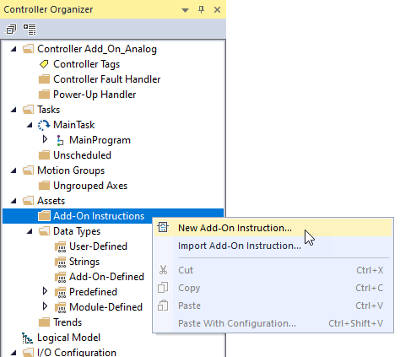
Add-On Instruction
To create an Add-On instruction, right click in the Controller Organizer Assets - Add-On Instructions.
Select the New Add-On Instruction… from the context menu.

Slide 6
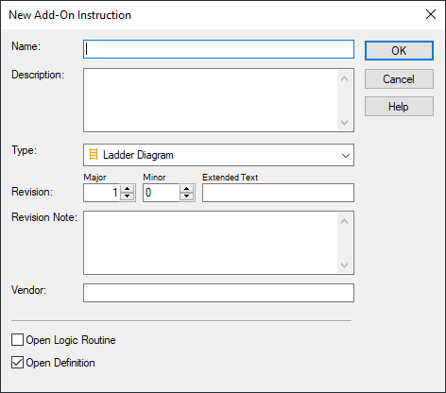
Add-On Instruction
The New Add-On Instruction dialog appears.

Slide 7
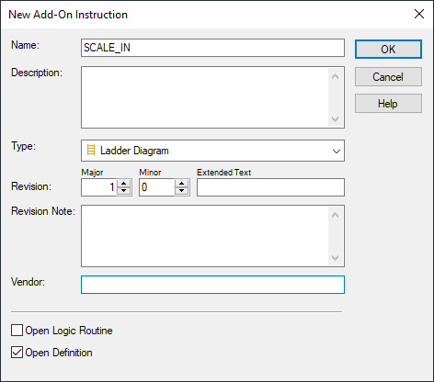
Add-On Instruction
Type a Name: for the instruction and any related documentation.

Slide 8
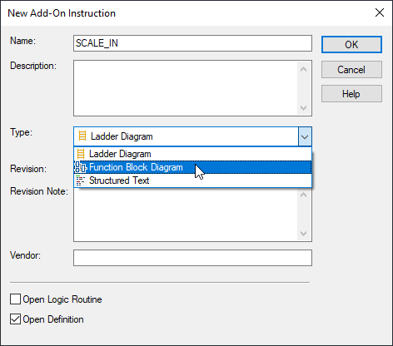
Add-On Instruction
In this example, an Add-On Instruction for scaling will be created in Function Block Diagram for use in a Ladder Logic program.

Slide 9
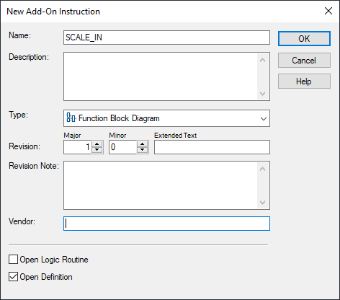
Add-On Instruction
Select the OK button to accept.

Slide 10
Entering the Parameters and Logic for the Add-On Instruction

Slide 11
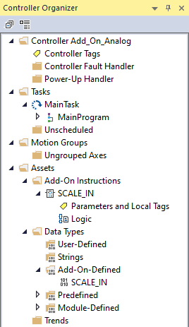
Add-On Instruction
Noticed in the Project Tree the Named Add-On Instruction is created with the Parameter and Local Tags and Logic entries.
Note: The dialog shown in the next slide will automatically open.

Slide 12
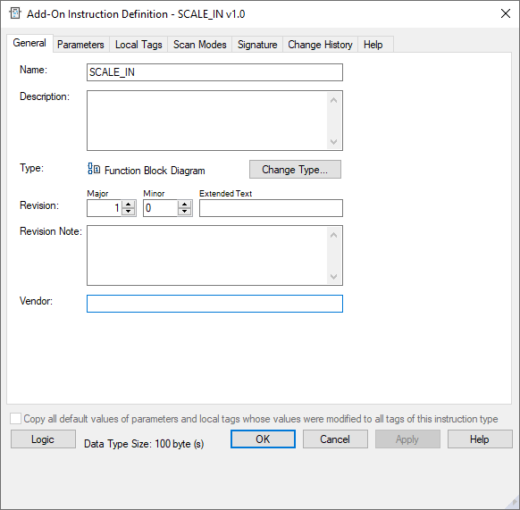
Add-On Instruction
Select the Parameters tab.

Slide 13
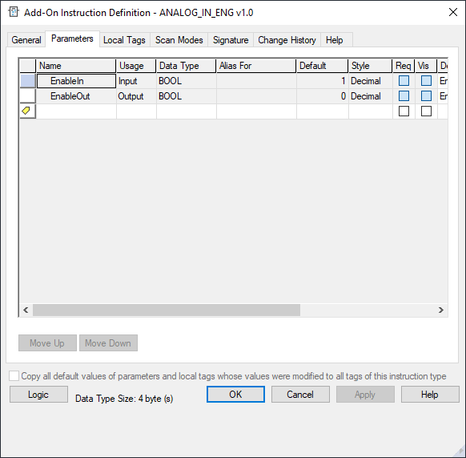
Add-On Instruction
The Add-On instruction Parameters table editor opens.

Slide 14
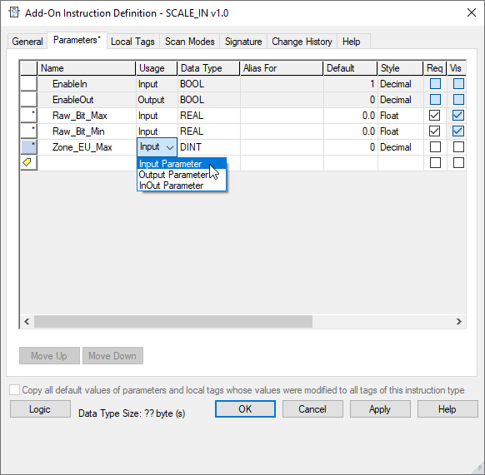
Add-On Instruction
Enter the Parameters required, tags for values used in the instruction.
A dropdown for Usage selects if the parameter is and Input or Output.

Slide 15
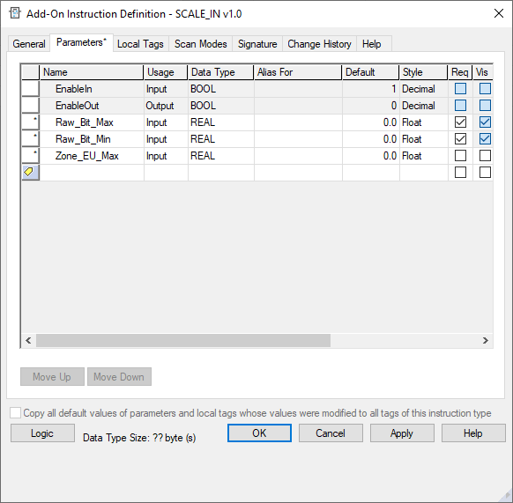
Add-On Instruction
Check the Req (Requires) and Vis (Visible) columns.
Req (Requires) if checked the parameter requires a Tag.
Vis (Visible) if checked the parameter will be displayed in the Add-On Instruction.

Slide 16
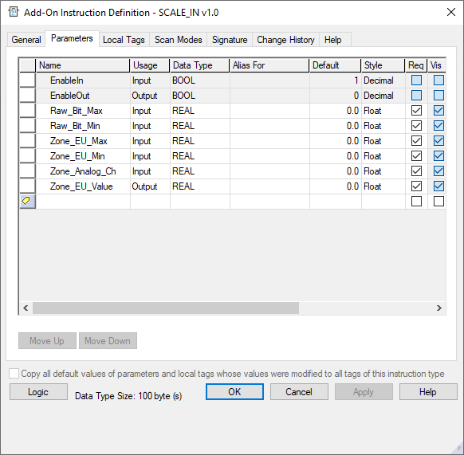
Add-On Instruction
The Data Type defined for Input Usage is data information from the application from for use by the Add-On Instruction.

Slide 17
Add-On Instruction
The Data Type defined for Output Usage is data information change by Add-On Instruction for use in the application program.

Slide 18
Add-On Instruction
Select the OK button to close.

Slide 19
Add-On Instruction
To open the Logic Editor double left click on the named Add-On Instruction’s Logic.

Slide 20
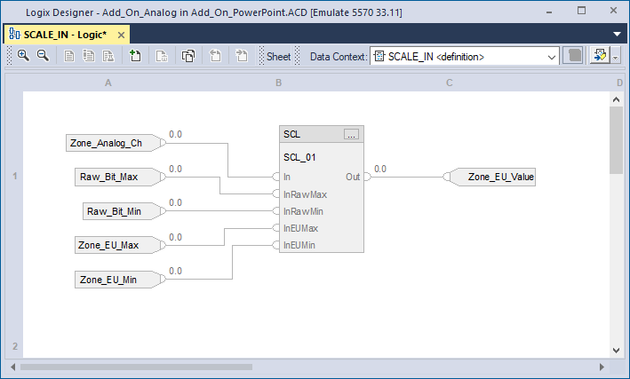
Add-On Instruction
Create the Logic for the Add-On Instruction.
The Function Block instruction for scaling is added and assigned the Parameter Tags.

Slide 21
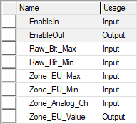
Add-On Instruction
Add-On Parameters
The Input Parameters are used with the Scaling instruction.

Slide 22
Add-On Instruction
The Output Parameters is the result of the Scaling instruction.
Add-On Parameters

Slide 23
Add-On Instruction
The Parameters and Logic can be selected and edited.

Slide 24
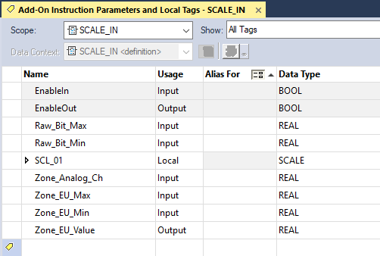
Add-On Instruction
If Parameters is selected a table opens with the Parameters and Local Tags
Notice no Vis or Req check boxes.

Slide 25
Add-On Instruction
If Logic is selected the program editor opens.

Slide 26
Add-On Instruction
If Add-On-Defined and Add-On name is selected the Add-On Instruction Definition opens .

Slide 27
Using the Add-On Instruction in the Application Program
In this example two of the Scaling Analog Input Add-On Instruction will be used.

Slide 28
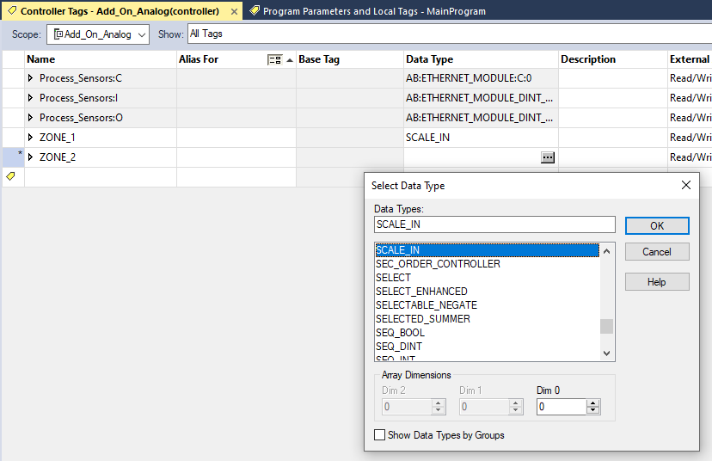
Add-On Instruction
A Data Type created by the Add-On Instruction is chosen from the Select Data Type dialog when creating the Tag for the Add-On Instruction.
Note: the Add-On Instruction Tag may be a Controller Tags or Program Parameter and Local Tags.

Slide 29
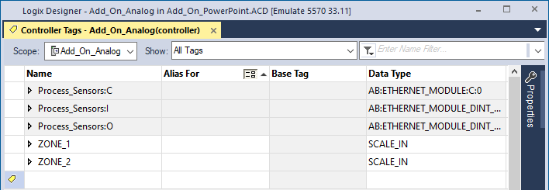
Add-On Instruction
Each of the Add-On Instructions in the Ladder Diagram application program has a Tag using the Add-On Instruction’s Data Type.
Individual Add-On instruction Tag.
Data Type of Add-On instruction.
ZONE_1 for the first Add-On Instruction.
ZONE_2 for the second Add-On Instruction.

Slide 30
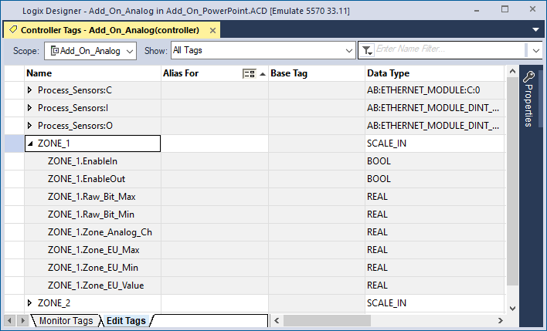
Add-On Instruction
The Add-On Instructions in the Ladder Diagram application program Tag uses the Add-On Instruction Parameters in the in the Data Type of the Add-On instruction.
Data Type of the Add-On instruction.
ZONE 1 Add-On instruction Tag.
Parameters from the Add-On instruction.

Slide 31
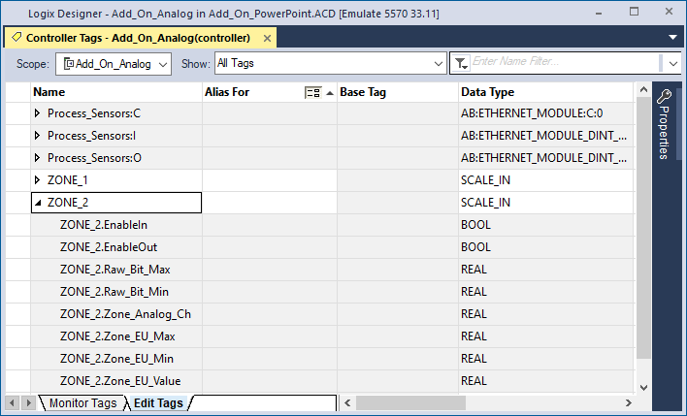
Add-On Instruction
Notice the Tags used by the Parameters are proceeded by the Tag Name for the used Add-On Instruction.
Data Type of the Add-On instruction.
ZONE 2 Add-On instruction Tag.
Parameters from the Add-On instruction.

Slide 32

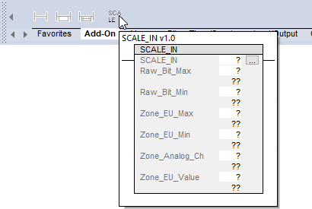
Add-On Instruction
The Add-On Instruction to Scale an Analog Input to Engineering Units is added to the application program from the Instruction Palette Add-On tab.
If the cursor is hovered over the instruction’s button a pop-up appears to show the instruction.
The Add-On Instruction can be dragged into the application program.

Slide 33
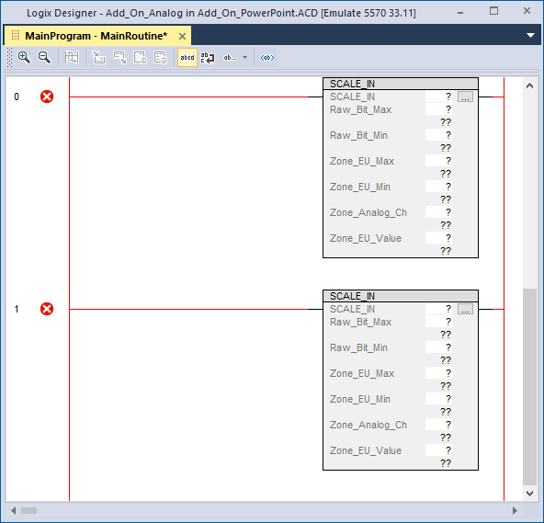
Add-On Instruction
Two of the Add-On instructions are dragged into the application program.

Slide 34
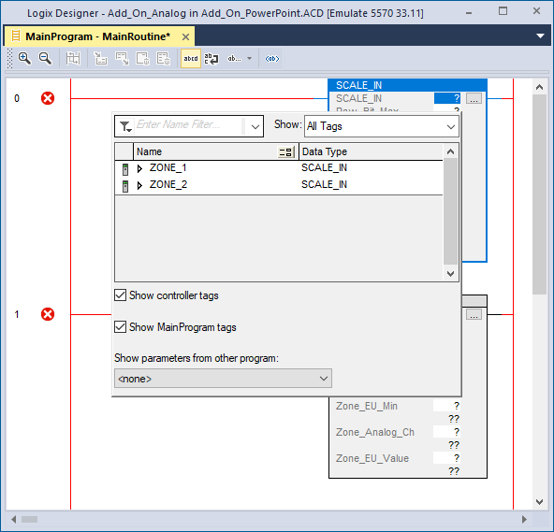
Add-On Instruction
The Tag for the Add-On Instruction is assigned

Slide 35
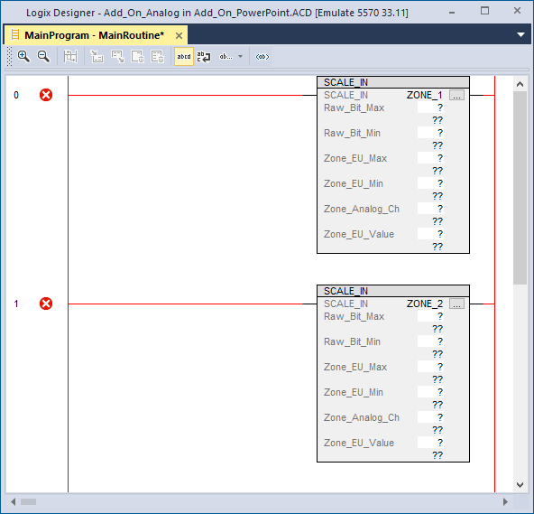
Add-On Instruction
The Add-On Instructions are assigned their named Tag.

Slide 36
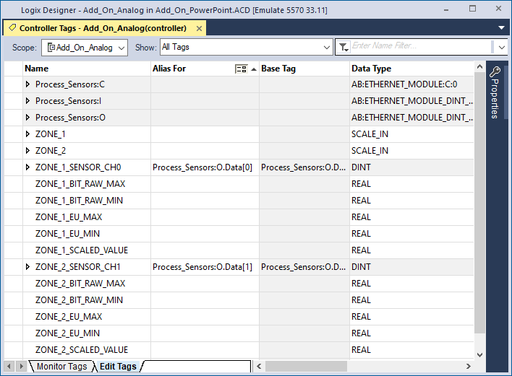
Add-On Instruction
Unique Data Tags for Zone 1 and Zone 2 data are created.
Data Tags are created for Zone 1.

Slide 37
Add-On Instruction
Unique Data Tags for Zone 1 and Zone 2 data are created.
Data Tags are created for Zone 2.

Slide 38
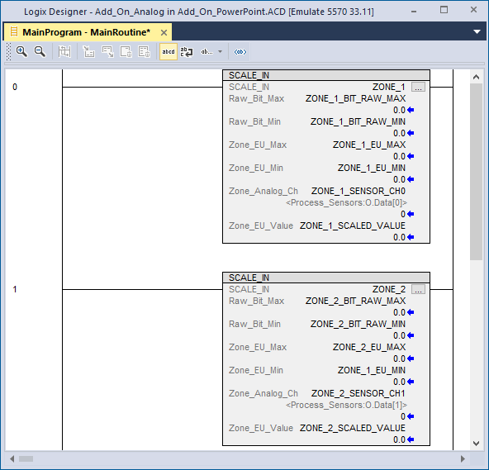
Add-On Instruction
The Parameters for the Add-On Instruction for the scaling.
Zone 1
Add On Parameters
Zone 2

Slide 39
Add-On Instruction
The Data Tags are assigned to the Add-On Instruction.
Data Tags for Zone 1 are assigned.

Slide 40
Add-On Instruction
The Data Tags are assigned to the Add-On Instruction.
Data Tags for Zone 2 are assigned.

Slide 41
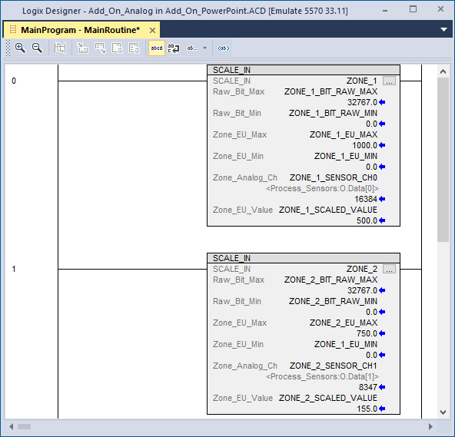
Add-On Instruction
The Tags created provide the data to be used for each of the instructions.
Zone 1
Zone 2

Slide 42
Add-On Instruction
The Parameter for the Zone_EU_Value is the Output result of the Add-On Instruction’s scaled value.
Add On Parameters
Zone 1 scaled value.
Zone 2 scaled value.

Slide 43
Add-On Instruction
There is common interface Add-On Instruction’s Data.
The Add-On Instruction is a re-usable
instruction that can be used with different data.

Slide 44
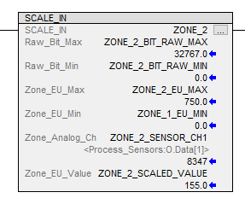
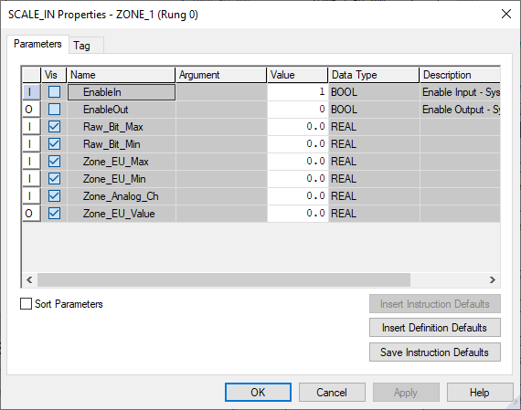
Add-On Instruction
The Add-On Instruction has a button that will display the instruction’s Properties.
Notice the Value column is not grayed out.
The Values may be viewed or changed.

Slide 45
Simplifying the Add-On Instruction in the Application Program

Slide 46
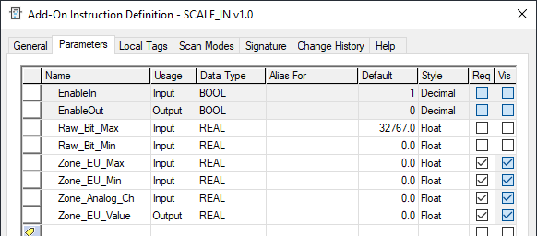
Add-On Instruction
The Add-On Instruction could be simplified by unchecking the Req and Vis for the Bit Maximum and Minimum and then hardcoding in the values.
The Bit values are fixed by the hardware and would not change.

Slide 47
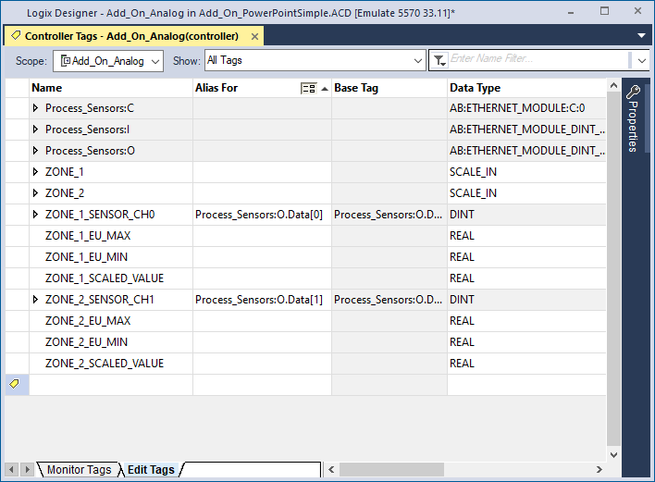
Add-On Instruction
No Tags for the Bit Maximum and Minimum would need to be created.

Slide 48
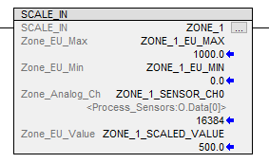
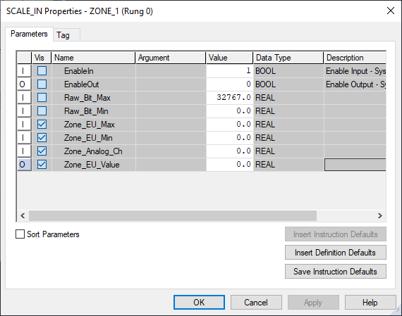
Add-On Instruction
The Bit Parameters would not be shown in the instruction but still used by the instruction’s Logic.

Slide 49
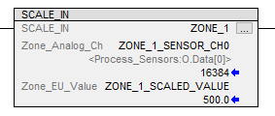
Add-On Instruction
The Engineering Units could also be simplified.
The instruction’s values for the Maximum and Minimum Engineering Units could be viewed or changed by selecting the instruction’s Properties button.

Slide 50
Add-On Instruction
Because the Add-On Instructions Tag, ZONE_1, would still list the Maximum and Minimum Engineering Units and Raw Bits Tags those tags could be viewed or changed by an HMI.

